Slide 1

Project name
Team Members

Slide 2
Types of pollution
Air Pollution
Water Pollution
Occurs when harmful or excessive quantities of substances including gases, particles, fumes, odour and biological molecules are introduced into Earth's atmosphere due to industrial process. Industrial air pollution can travel long distances, sometimes few miles due to changing weather patterns, and study of weather patterns is essential while predicting the air quality. Car emissions, chemicals from factories in gaseous, and dust, pollen, mold spores may be suspended as particles.
Is the contamination of water bodies, usually as a result of Industrial activities, with any chemical, physical or biological change in the quality of water that has a harmful effect. Water bodies include for lakes, rivers, oceans, aquifers and groundwater. Were contaminants enter a waterway from a single, identifiable source, such as a pipe, drains etc.

Slide 3
Types of pollution
Land Pollution
Noise Pollution
is the contamination and destruction of the earth’s land surfaces, often directly or indirectly typically caused by industrial activity, agricultural chemicals or improper disposal of waste. sewage sludge, fertilizer, heavy metals, urban waste etc.
is the propagation of noise with harmful impact on the humans, when it either interferes with normal activities such as sleeping, conversation, or disrupts normal hearing. Source of outdoor noise is mainly caused by machines, transport (especially planes) and propagation systems

Slide 4
Facilities in plant layouts
Industry | Waste Produced | Type of pollution
Caustic Soda | Mercury, Chlorine gas | Air, water and land
Cement dust, smoke | Particulate matter | Air, water
Distillery | Organic waste | Land and water
Fertiliser | Ammonia, cyanide, oxides of nitrogen, oxides of sulphur | Air and water
Dye | Inorganic waste pigment | Land and water
Iron and steel | Smoke, gases, coal dust, fly ash, fluorine | Air, water and land
Pesticides | Organic and inorganic waste | Water and land

Slide 5
Facilities in plant layouts
Industry | Waste Produced | Type of pollution
Paper and Pulp | Smoke, organic waste | Air and water
Sugar | Organic waste, molasses | Land and water
Textiles | Smoke, particulate matter | Land and water
Tanneries | Organic waste | Water
Thermal power | Fly ash, SO2 gas | Air and water
Food processing | Alkalies, phenols chromates, organic wastes | Water and land
Oil Refineries | Smoke, toxic gases, organic waste | Air and water

Slide 6
Facilities in plant layouts
MANUFACTURING | MINING | POWER PLANT | TANNERY
Mixing units | Tailings | Stock Pile | Loading Area
Boilers | Slurry | Conveyor | Storage Area
Incinerators | Drainage Pipes | Hopper | Beamhouse
Cooling Towers | Mixtures of Minerals | Boilers | Storage tanks
Effluent Treatment Plant | Groundwater Level | Flue gas cleaning unit | Crusting floor
Analytical Laboratories | Microflora | Cooling unit | Drain Pipes
Warehouse | Soil Fertility | Pulverizer | Effluent treatment Plant
Storage Tanks | Soil Texture | Generator | Warehouse

Slide 7
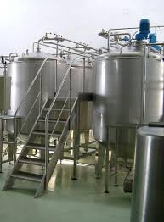
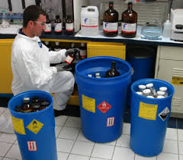
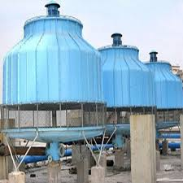
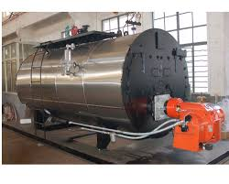
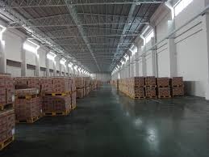
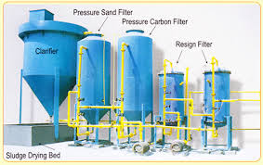
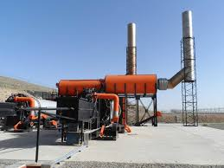
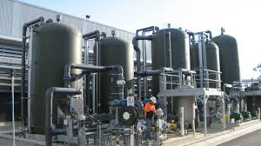
Images of MANUFACTURING Facilities

Slide 8
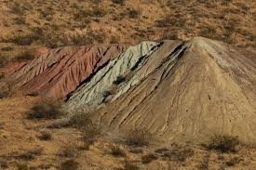
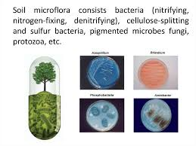
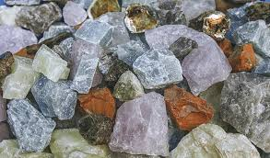
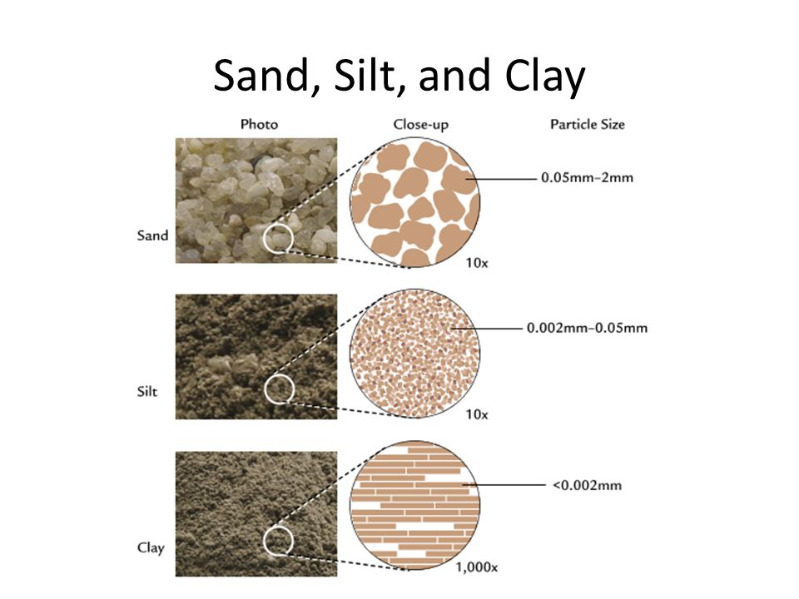
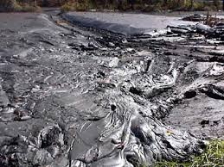
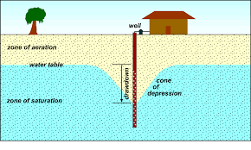
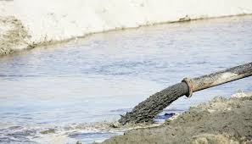
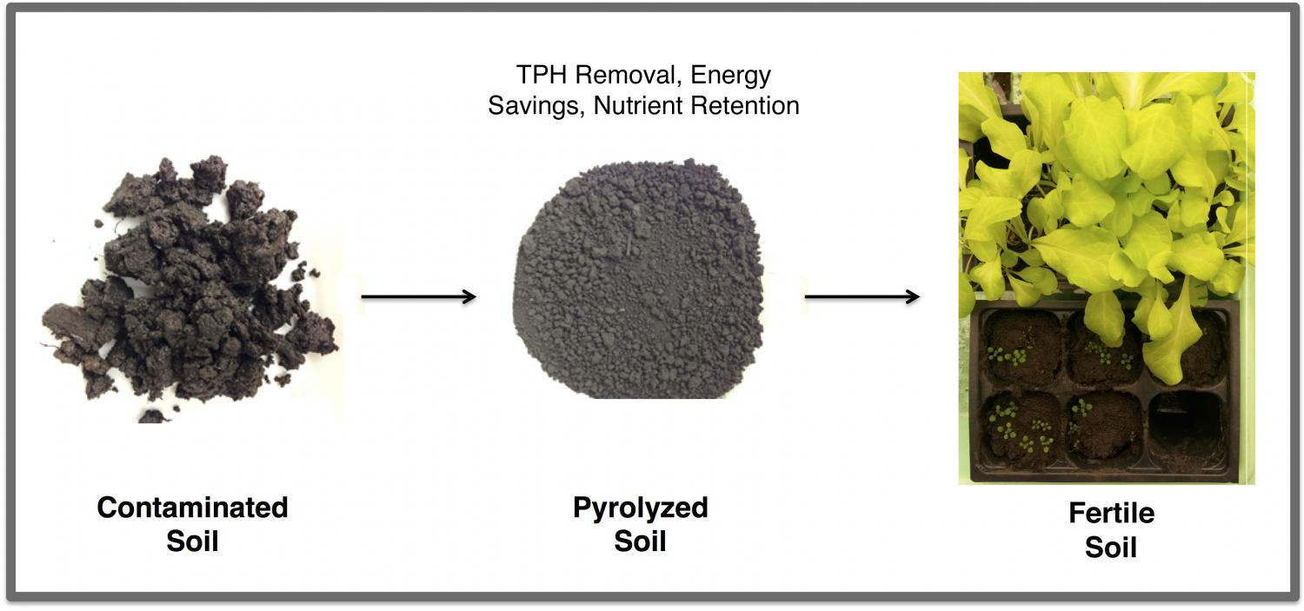
Images of MINING Facilities

Slide 9
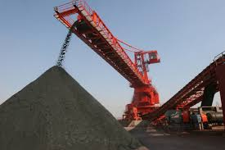
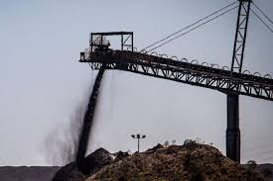
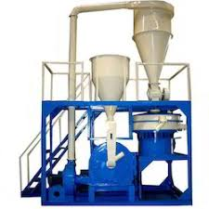
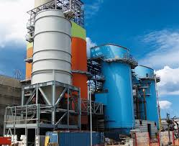
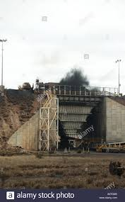
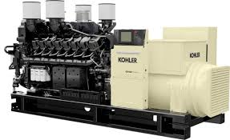
Images of POWER PLANT Facilities

Slide 10

THANK YOU

